Slide 1
Sabrina Carpenter Discography
Logan Camacho (ljc5809), Ariana Netteville (aqn5523), Nurin Mustapa (nim5313)
Sanjana Vuppunahalli (szv5306@psu.edu)

Slide 2


This database consists of the music discography of artist Sabrina Carpenter.
It includes Track ID, Track Names, Genre, Duration, Album Name, Album Sales, Spotify Streams, Spotify US Peak, Video Clip(y/n), Youtube Views, and Release Date.
Data collected online through a data science platform, kaggle.
We used 30 songs on the list of 68 songs
Project Database Summary

Slide 3
Tables
Album
A total of 6 albums
Consists of AlbumID, Album Name, and Album Sales.
Track
Songs by Sabrina Carpenter
We selected 5 songs from each album (total of 30 songs)
Consists of TrackID, TrackName, TrackGenre, Duration, ReleaseDate, and AlbumID.
Media
Media information of each track
Consists of
MediaID,
TrackVideoClip,
VideoclipViews, SpotifyStreams, USAPeak, and
TrackID.
Notes:
There are three entities representing three different database tables.
Album entity is for storing album information. We also have a Track entity that contains 30 Sabrina Carpenter’s songs including their genres, durations and release dates so to differentiate each track. The Media entity is for keeping track of views and streams on multiple streaming platforms like Youtube and Spotify.

Slide 4
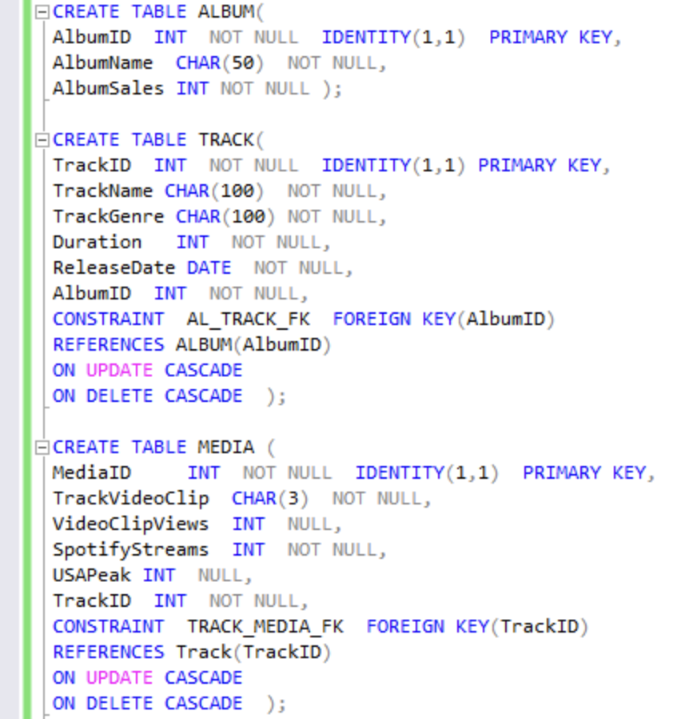
Tables
Album
ALBUM(AlbumID, AlbumName, AlbumSales)
Track
TRACK(TrackID, TrackName, TrackGenre, Duration, ReleaseDate, AlbumID)
Media
MEDIA(MediaID, TrackVideoClip, VideoclipViews, SpotifyStreams, USAPeak, TrackID)
Notes:
SQL statements to create tables

Slide 5
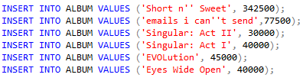
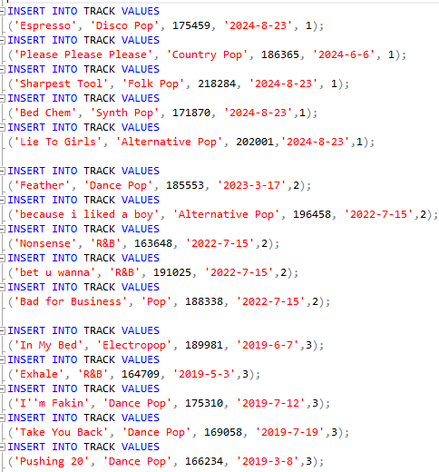
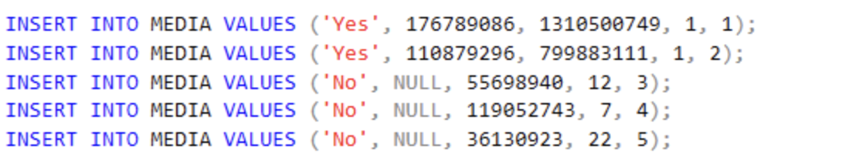
Tables
Album
Track
Media
Notes:
SQL statements to insert data into tables. For this presentation, we are only showing the insertion data for the short n sweet album.

Slide 6
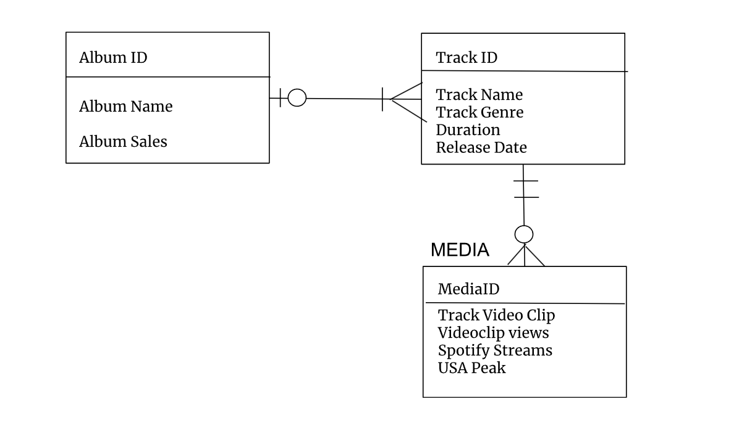
E-R Diagram

Slide 7
Queries
Which songs peaked in the top 5 on the USA Charts?
Which songs have a video clip/music video?
What is her most popular album?
Which song has the longest duration?
Which songs belong to the “short n’ sweet” album and have a genre of country pop?
How many tracks belong to each genre?

Slide 8


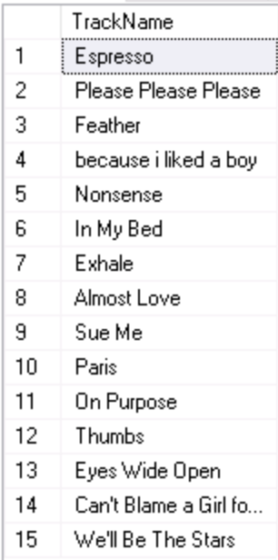

Which songs peaked in the top 5 on the USA Charts?
Which songs have a video clip(a music video)
Notes:
-Changed USAPeak to have NULL option, instead of 0

Slide 9


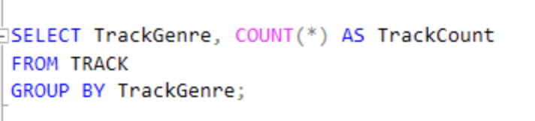
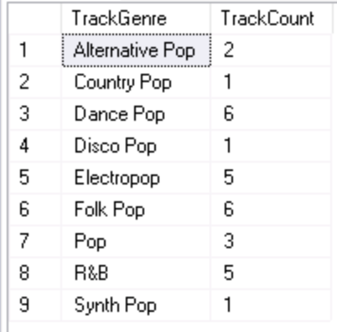
Her most popular album?
How many tracks belong to each genre?

Slide 10




Which song is longest in duration?
Which songs belonging to the “short n’ sweet” album have a genre of country pop?

Slide 11
Thank you

Slide 12
Citations
https://www.kaggle.com/datasets/delfinaoliva/sabrina-carpenter-discography

